Slide 1

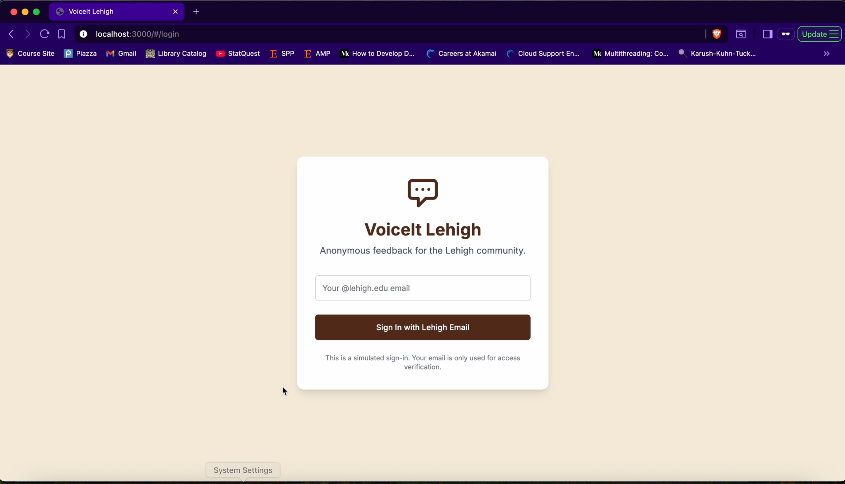
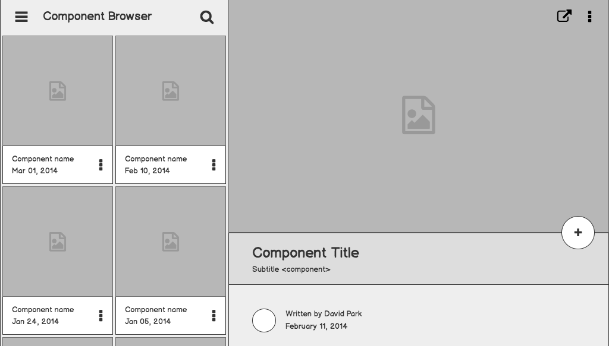

Voice It-Lehigh
Tagline: Anonymous, Real-Time Feedback Platform for Lehigh Students
Team Members: Annie Poon, Wiesmes Antwi, Andy Llanos

Slide 2
Problem statement
Courses and organizations need real time feedback
Too often feedback is given when it's too late to make tangible change in the moment.

Slide 3
What students do today
This is how students/faculty/organizations are dealing with the problem .
Students just talk about it with their friends and “deal with it”
Teachers wait until the end of semester to know what they need to improve on to help their students
Some organizations try to create google forms after sessions

Slide 4
Assumptions
Students want a platform to speak up on what needs to be changed around them.
Faculty want to hear students feedbacks and improve their teachings.
Club organizations and greek houses want ideas and feedback from their group.

Slide 5
Solution description
Build a platform where students can:
Submit anonymous feedback anytime
Send feedback to professors, clubs, teams, or organizations
Receive real-time responses or changes
Automatically detect and block offensive or toxic language
Encourage constructive criticism and improvement

Slide 6
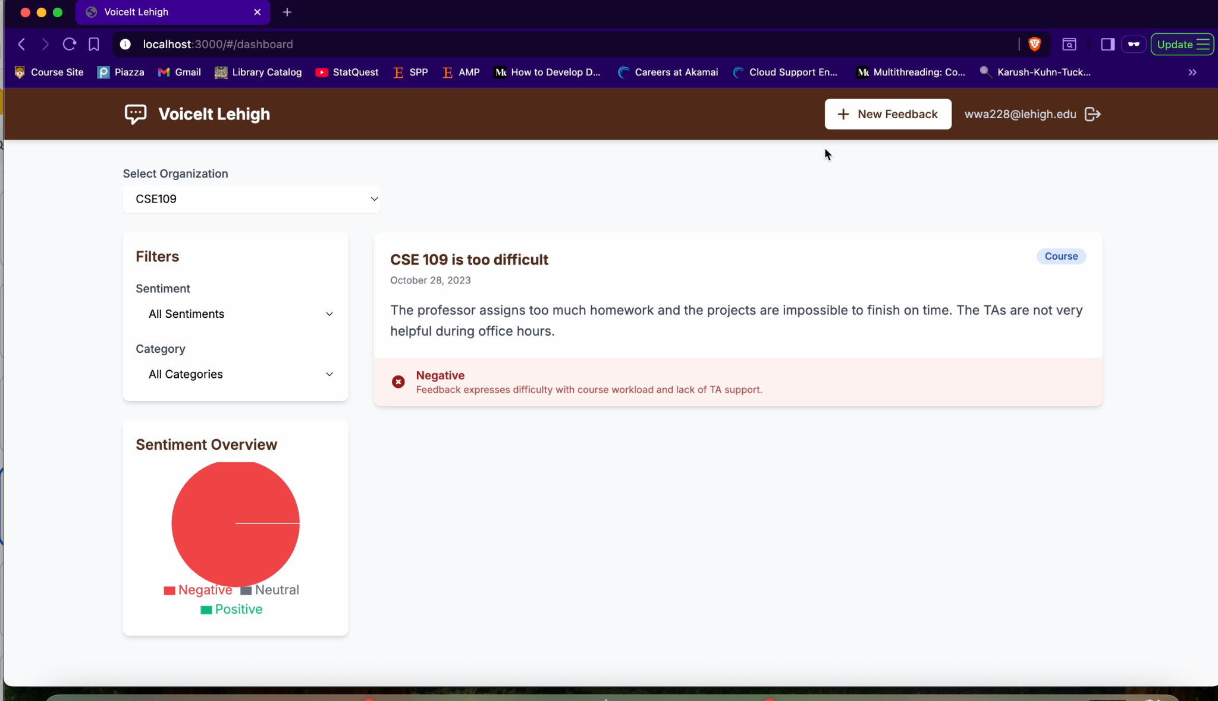

Slide 7
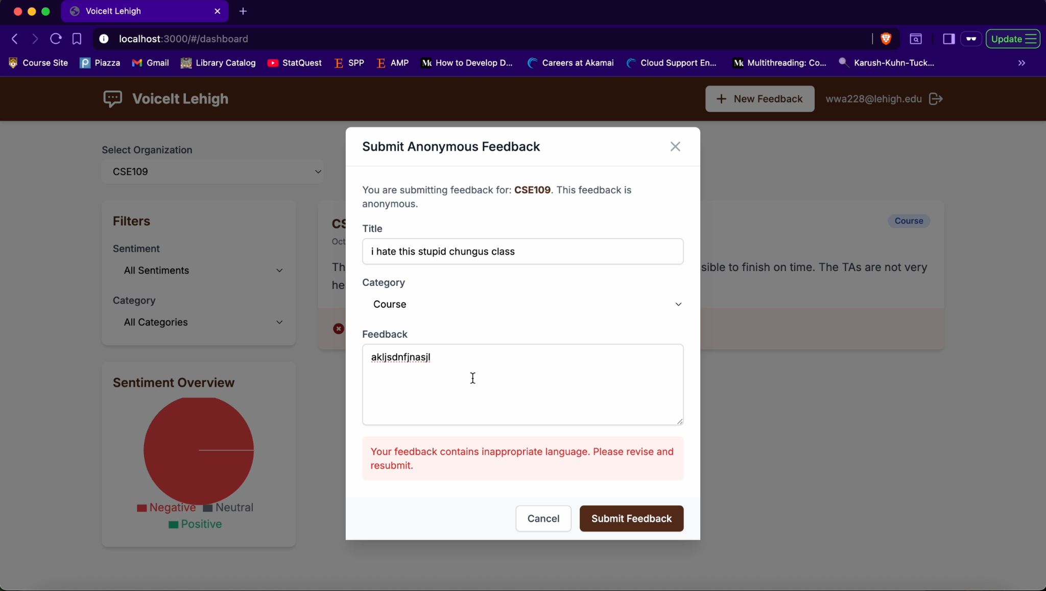
Component Detail

Slide 8
Contacts
Final Impact
Improves communication
Giving students a voice today, not at the end of the semester.
Builds trust between students & leaders
Creates a culture of growth and feedback at Lehigh

Slide 9
Questions?

